Slide 1
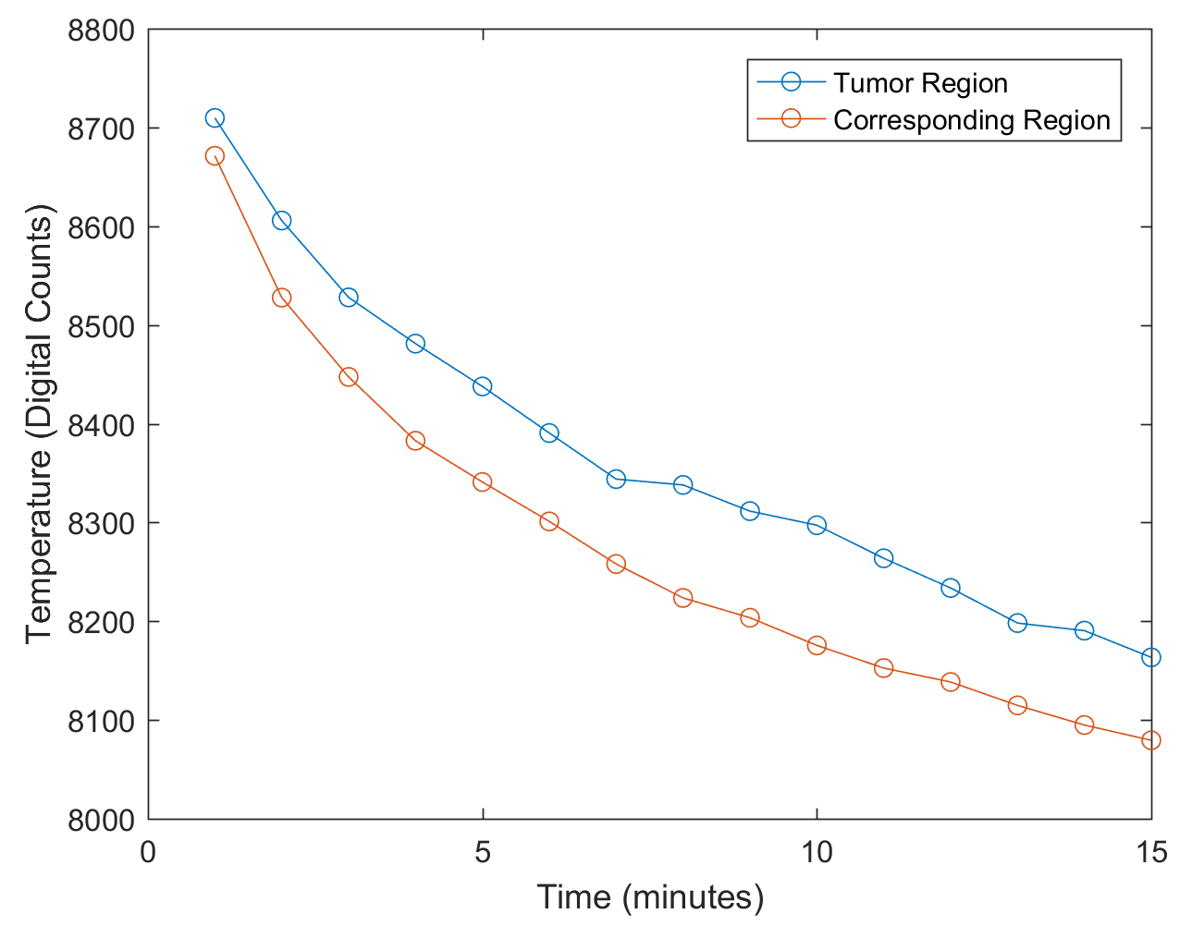
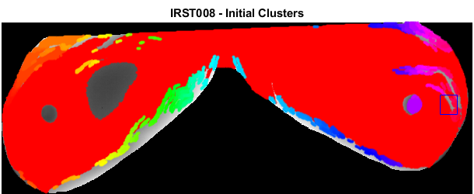
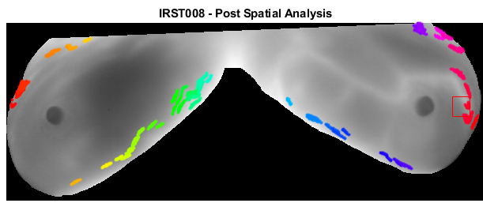
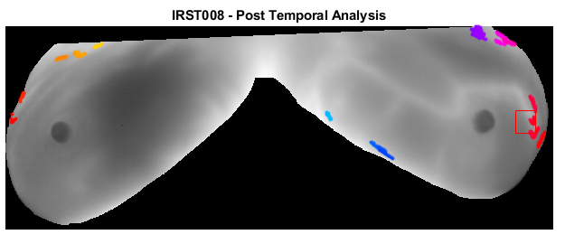
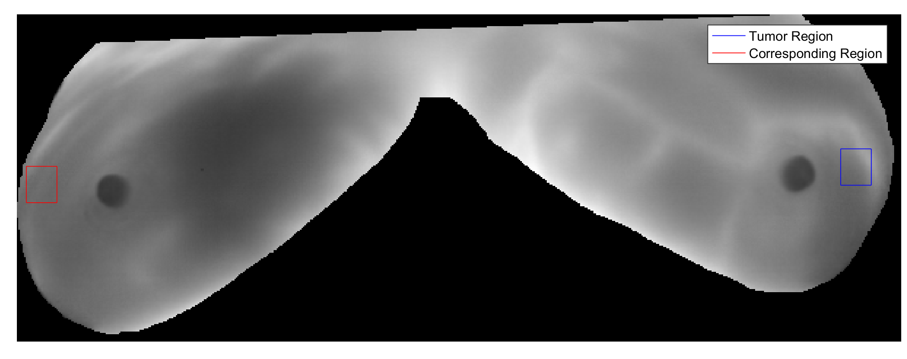
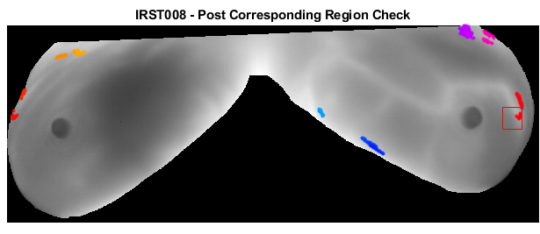
Cluster Analysis in Thermal Imaging to Aid in the Diagnosis of Breast Cancer Sydney Bailes¹, Jacob Halle², and Murray Loew¹
¹Dept. of Biomedical Engineering - George Washington Univ., Washington, DC USA ² Dept. of Biomedical Engineering - Pennsylvania State Univ., State College, PA USA
OBJECTIVE
RESULTS
DISCUSSION & FUTURE WORK
The objective of this study is to develop an algorithm for accurately detecting breast tumors based on thermal analysis over time. A clustering algorithm is paired with thermal analysis to isolate potentially tumorous regions of the breast.
 | Total Change (digital Counts) |  | Average Rate of Change (digital Counts)
Patient | Tumor Region | Corresponding Region | Tumor Region | Corresponding Region
IRST004 | -207.628 | -241.915 | -14.8306 | -17.2796
IRST005 | -96.8071 | -198.8 | -6.9148 | -14.203
IRST008 | -431.2399 | -603.1235 | -30.8029 | -43.0802
IRST011 | -351.0627 | -597.3856 | -25.0749 | -41.3847
The comparison of the thermal characteristics of the truth region and corresponding region on the healthy breast verified that the tumorous region changed less over 15 minutes and had a slower rate of change. While all of the truth regions exhibited those characteristics, some of the normal regions exhibited this behavior as well, making it clear that additional checks were needed to eliminate clusters.
The checks described helped reduce the number of clusters by 90-93%, yielding clusters in and around the truth region with a few additional clusters. Ideally the cluster removal methods would be able to eliminate all clusters except for those in the area of the truth region; however, there were several factors preventing this, including:
Inherent non-uniformity in the breast tissue
Blood vessels that have similar characteristics to tumors
Lack of symmetry that makes it difficult to compare an area on one breast to the same spot on the other breast
Patient movement made it difficult to track a cluster over time
INTRODUCTION
The initial stages of breast cancer are characterized by an increase in vascularity of areas where a tumor is present. This causes the affected area to be warmer than surrounding tissue, and cool at a slower rate when exposed to ambient conditions [1].
These characteristics allow thermographic analysis of a patient’s breasts to potentially be used to diagnose early stages of breast cancer.
Table 1. Total Change and Average Rate of Change of Tumor Region and Corresponding Region for Patients: Tumor region changes less and at a slower rate.
Figure 2. Average Intensity over Time of Tumor Region and Corresponding Region: Tumor region is warmer and cools slower
Initial Clustering
Spatial Checks
Temporal Check
Small Clusters
Corresponding-region Check
Large Clusters
High total change
High average rate of change
Using DBSCAN
DBSCAN parameters change per patient
Long/Narrow Clusters
Clusters cooler than opposite side removed
MATERIALS & METHODS
Acquire Images:
Patients were imaged over the course of 15 minutes with an N2 Infrared Camera with thermal resolution of 50 mK / Digital Count.
Crop images to include only breast tissue
Tumor Region vs. Corresponding Region
Truth region on breast with tumor identified, and average temperature was tracked over 15 minutes
Corresponding region on the healthy breast identified, and average temperature was tracked over 15 minutes
Total change and rate of change over 15 minutes for both areas was calculated
Cluster Isolation:
DBSCAN (Density Based Spatial Clustering of Applications with Noise) was used to generate an initial group of clusters with similar temperatures near each other [2].
Clusters were then run through a series of tests to eliminate those that were likely not tumorous
Spatial Test
Temporal Test
Corresponding Region Test
(a)
Although these results are promising, additional improvements to the algorithm are needed in order to fully reach the goal of being able to use thermography for breast cancer detection. Furthermore, more patients should be imaged to ensure the algorithm can work for a wide range of patients.
Remove Clusters
(b)
CONCLUSION
(c)
The comparison of the thermal characteristics of the truth region to the same region on the opposite breast supported the evidence that tumorous regions are warmer and change less over time. This information, as well as the use of spatial and temporal information in the removal of clusters shows the promise of thermographic analysis as a means of breast cancer diagnosis. As more data are acquired and the methods of cluster removal are refined, the reliability of breast thermography will increase and contribute towards its acceptance in the medical field.
Figure 1. Tumor Region (blue) and Corresponding Region (red) for IRST008
(d)
Figure 3. Cluster Removal Process and Results for IRST008 at Each Stage: For IRST008 the checks removed 93.06% of the initial clusters and left clusters in and around the truth region.
Patient | Initial # of Clusters | Final # of Clusters | Percent Reduced
IRST004 | 287 | 23 | 91.99
IRST005 | 235 | 15 | 93.62
IRST008 | 245 | 17 | 93.06
IRST011 | 116 | 7 | 93.97
REFERENCES
[1] Li Jiang, et al., Phys. Med. Biol. 56 (2011). 187–202
[2] Yarpiz (2015). DBSCAN Clustering Algorithm, MATLAB Central File Exchange. Retrieved July 2017.
Table 2. Initial and Final Number of Clusters for Each Patient: The reduction was over 90% for all patients
Notes:
----- Meeting Notes (9/28/17 17:09) -----
- Goals: Develop Algorithm for image analysis to assist in clinical decision making. The algorithm should distinguish between normal and tumorous breast tissue accurately.

